Slide 1
XPath
Language for retrieving information from a XML document.

Slide 2
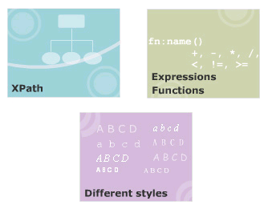
Module Introduction
Welcome to the module, More on XSLT.
Understanding on XPath, and identifying the various nodes of XPath.
Lists the different operators used with XPath and describes the various XPath expressions and functions.
Explains how to switch between styles and how to transform XML documents into HTML using XSLT.
In this module, you will learn about:
  Xpath
  XPath Expressions and Functions
  Working with different styles

Slide 3
#1 - XPath
Define and describe XPath
Identity nodes according to XPath
List operator used with Xpath
Describe the types of matching

Slide 4
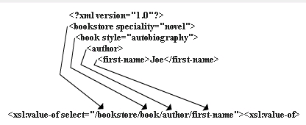
XPath
Language for retrieving information from a XML document.
Use to navigate through elements and attributes in an XML document.
Allows identifying parts of an XML document.
Provides a common syntax shared by XSLT and XQuery.
  XSLT
  XQuery: language for extracting information from XML documents

Slide 5
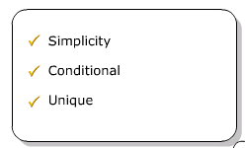
Benefits of XPath
Syntax is simple for the simple and common cases.
Any path that can occur in an XML document and any set of conditions for the nodes in the path can be specified.
Any node in an XML document can be uniquely identified.
XPath is designed to be used in many contexts.
Applicable to providing links to nodes, for searching repositories, and for many other applications.

Slide 6
XML Document in XPath
In XPath, an XML document is viewed conceptually as a tree in which each part of the document is represented as a node.
XPath have seven types of node. They are:
  Root
  Element
  Attribute
  Text
  Comment
  Processing instruction
  Namespace

Slide 7
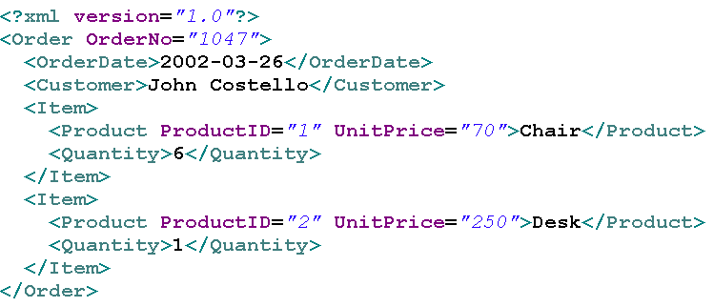
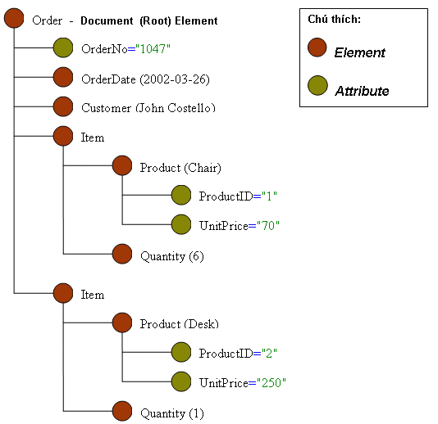
XPath Tree Example

Slide 8
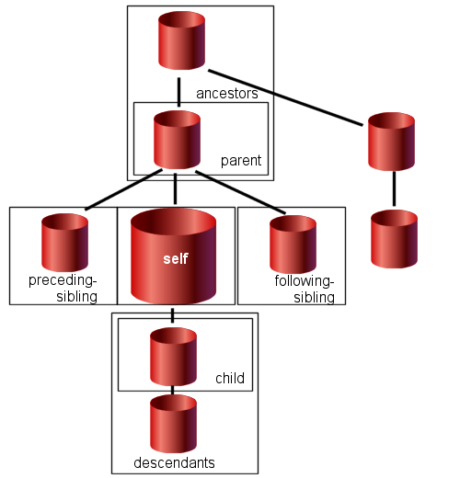
Relationship between nodes

Slide 9
Operators in XPath
XPath provides:
  Basic floating point arithmetic operators (*, div, mod +, -)
  Comparison and Boolean operators. (<=, <, >=, > =, !=, and, or)

Slide 10
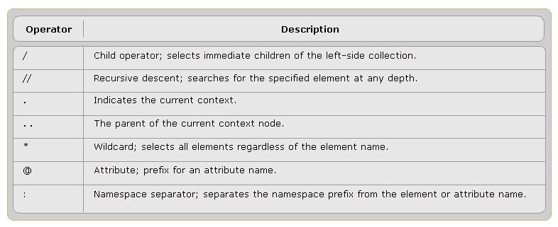
XPath expressions
Can returns: a node set, a boolean, a string, a number.
Are constructed using the operators and special characters

Slide 11
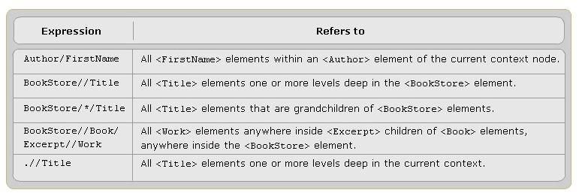
Examples of XPath Operators

Slide 12
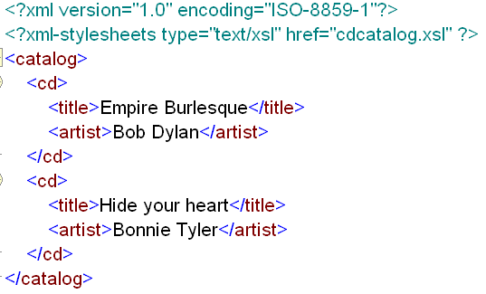
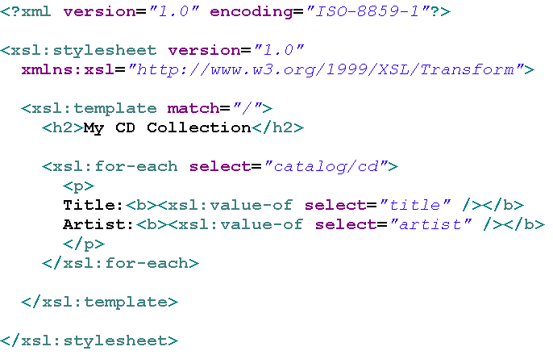
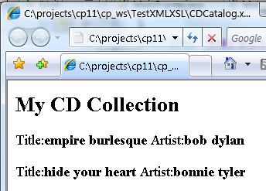
Examples of XPath Operators
xml document
xsl document
output

Slide 13
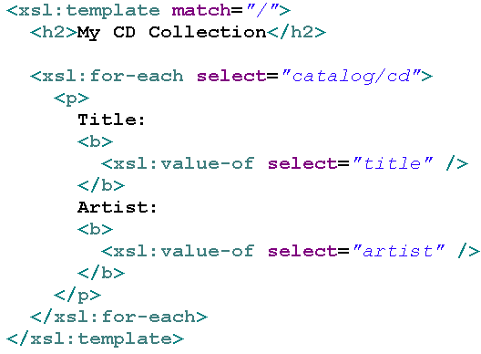
Types of Matching
Matching by name
Matching by ancestry
Matching the element names
Matching the root
Matching by attribute

Slide 14
Example of XPath Matching
Path Expression | Result
/bookstore/book[1] | Selects the first book element that is the child of the bookstore element.
/bookstore/book[last()] | Selects the last book element that is the child of the bookstore element
/bookstore/book[last()-1] | Selects the last but one book element that is the child of the bookstore element
/bookstore/book[position()<3] | Selects the first two book elements that are children of the bookstore element

Slide 15
Example of XPath Matching
//title[@lang] | Selects all the title elements that have an attribute named lang
//title[@lang='eng'] | Selects all the title elements that have an attribute named lang with a value of 'eng'
/bookstore/book[price>35.00] | Selects all the book elements of the bookstore element that have a price element with a value greater than 35.00
/bookstore/book[price>35.00]/title | Selects all the title elements of the book elements of the bookstore element that have a price element with a value greater than 35.00

Slide 16
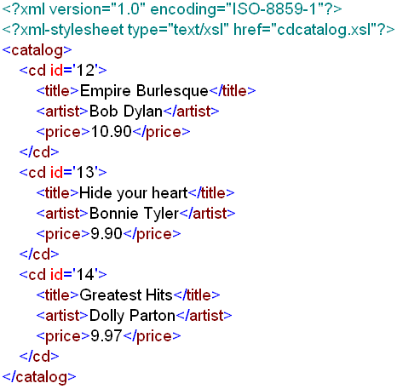
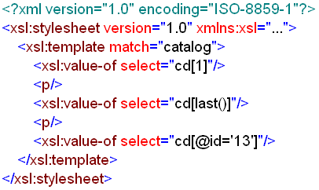
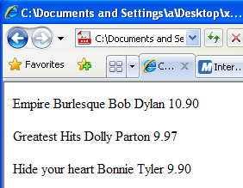
Example of XPath Matching
xml document
xsl document
output

Slide 17
XPath Expressions and Functions
State and explain the various XPath expressions and functions.
List the node set functions.
List the boolean functions.
State the numeric functions.
Describe the string functions.
Explain what result tree fragments are.

Slide 18
XPath expressions and functions.
XPath Expressions are statements that can extract useful information from the XPath tree.
Every XPath expression evaluates to a single value.
There are four types of expressions in Xpath.
  Node set
  Boolean
  Number
  String

Slide 19
Xpath core functions
Node Set Functions
String Functions
Boolean Functions
Number Functions

Slide 20
@1 - Node Set Functions
Return value | Function name
number | last()
number | position()
number | count(node-set)
node-set | id(object)
string | local-name(node-set?)
string | namespace-uri(node-set?)
string | name(node-set?)

Slide 21
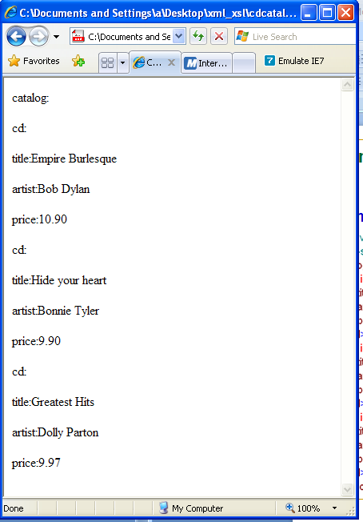
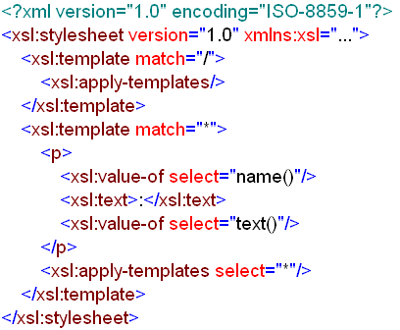
Example of Node Set Functions
xml document
xsl document

Slide 22
@2 - String Functions
Return value | Function name
string | string(object?)
string | concat(string, string, string*)
boolean | starts-with(string, string)
boolean | contains(string, string)
string | substring-before(string, string)
string | substring-after(string, string)
string | substring(string, number, number?)
number | string-length(string?)
string | normalize-space(string?)
string | translate(string, string, string)

Slide 23
@3 - Boolean Functions
Return value | Function name
boolean | boolean(object)
boolean | not(object)
boolean | true()
boolean | false()
boolean | lang(string)

Slide 24
@4 - Number Functions
Return value | Function name
number | number(object?)
number | sum(node-set)
number | floor(number)
number | ceiling(number)
number | round(number)

Slide 25
#3- Working with different styles
Explain how to switch between styles.
Describe how to transform XML documents into HTML using XSLT

Slide 26
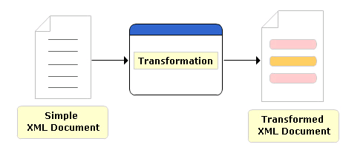
Transformation of XML document
XML can be transformed by changing its structure, its markup, and perhaps its content into another form.
Some uses of transformation are:
  Formatting a document to create a high-quality presentational format.
  Changing one XML vocabulary to another.
  Extracting specific pieces of information and formatting them in another way.
  Changing an instance of XML into text
  Reformatting or generating content.

Slide 27
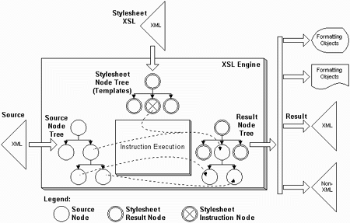
Transformation using an XSLT processor

Slide 28
Transforming XML using XSLT
Step 1: Creating a normal XML document:
  <?xml version="1.0" encoding="UTF-8"?>
Step 2: Create an XSL stylesheet:
  <?xml version="1.0" encoding="ISO-88S9-l"?>
  <xsl:stylesheet xmlns:xsl="http://www.w3.org/1999/XSL/Transform" version="l.D“>
  …….
  </xsl:stylesheet>
Step 3: Set it up to produce HTML-compatible output:
  <xsl:stylesheet>
    <xsl:output method="html"/>
    …
  </xsl:stylesheet>

Slide 29
Transforming XML using XSLT Example
Please see your CDs

Slide 30
That’s about all for today!
XPath
XPath Expressions and Functions
Working with different styles
Thank you all for your attention and patient !

